Slide 1
Machine Independent
Macro Processor Features
Concatenation of Macro Parameters
Generation of Unique Labels
Conditional Macro Expansion
Keyword Macro Parameters

Slide 2
Concatenation of Macro Parameters
Concatenate parameters with other character stings, for example:
  A program contains a set of series of variables:
    XA1, XA2, XA3,…
    XB1, XB2, XB3,…
    :
  The programmer wants to write a macro to process each series of variables.
    The programmer specifies the series of variables to be operated on (A, B, …).
    The macro processor construct the symbols by concatenating X, (A, B, …), and (1,2,3,…) in the macro expansion.

Slide 3
Concatenation of Macro Parameters
Suppose such parameter is named &ID, the macro body may contain a statement:
LDA X&ID1, in which &ID is concatenated after the string “X” and before the string “1”.
  → LDA XA1 (&ID=A)
  → LDA XB1 (&ID=B)
Ambiguity problem:
  E.g., X&ID1 may mean
    “X” + &ID + “1”
    “X” + &ID1
  This problem occurs because the end of the parameter is not marked.
Solution to this ambiguity problem:
  Use a special concatenation operator “->” to specify the end of the parameter
  X&ID->1

Slide 4
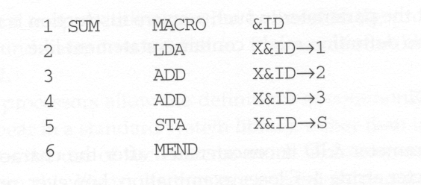
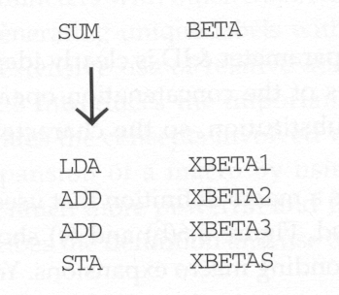
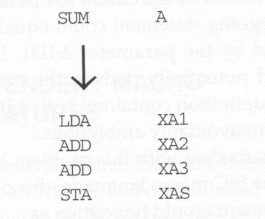
Example of Concatenation

Slide 5
Generation of Unique Labels
Labels in the macro body may cause “duplicate labels” problem if the macro is invocated and expanded multiple times.
Use of relative addressing at the source statement level is very inconvenient, error-prone, and difficult to read.
It is highly desirable to
  let the programmer use label in the macro body
    Labels used within the macro body begin with $.
  let the macro processor generate unique labels for each macro invocation and expansion.
    During macro expansion, the $ will be replaced with $xx, where xx is a two-character alphanumeric counter of the number of macro instructions expanded.
    XX=AA,AB,AC,…..

Slide 6
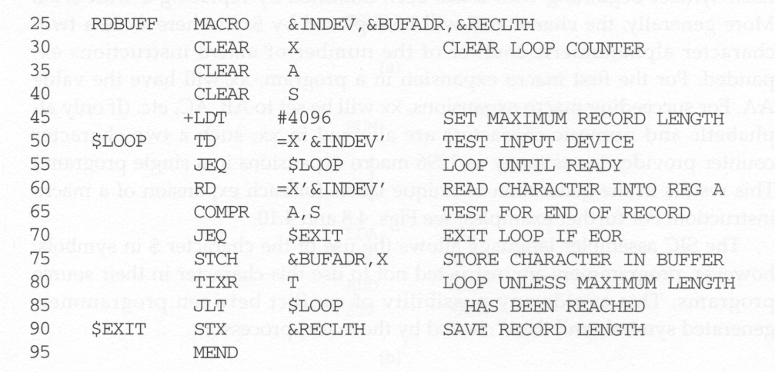
Labels Defined in Macro Body

Slide 7
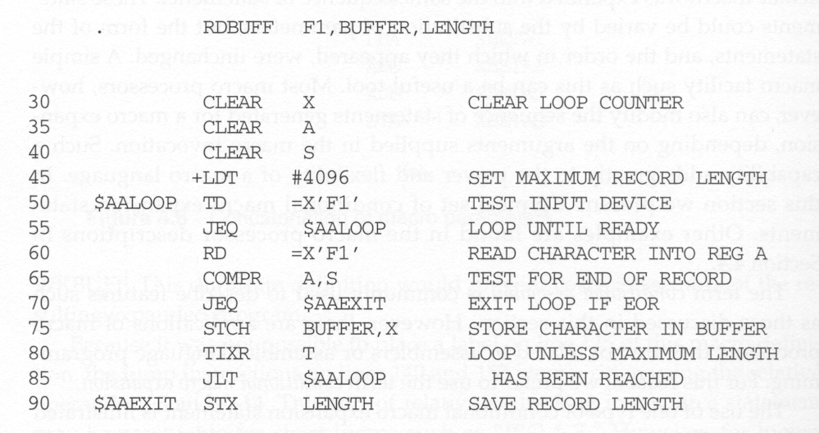
Unique Labels within Macro Expansion

Slide 8
Conditional Macro Expansion
Arguments in macro invocation can be used to:
  Substitute the parameters in the macro body without changing the sequence of statements expanded.
  Modify the sequence of statements for conditional macro expansion (or conditional assembly when related to assembler).
    This capability adds greatly to the power and flexibility of a macro language.
Macro-time conditional structure
  IF-ELSE-ENDIF
  WHILE-ENDW

Slide 9
Example of Conditional Macro Expansion
Two additional parameters used in the example of conditional macro expansion
  &EOR: specifies a hexadecimal character code that marks the end of a record
  &MAXLTH: specifies the maximum length of a record
Macro-time variable (set symbol)
  can be used to
    store working values during the macro expansion
    store the evaluation result of Boolean expression
    control the macro-time conditional structures
  begins with “&” and that is not a macro instruction parameter
  be initialized to a value of 0
  be set by a macro processor directive, SET

Slide 10
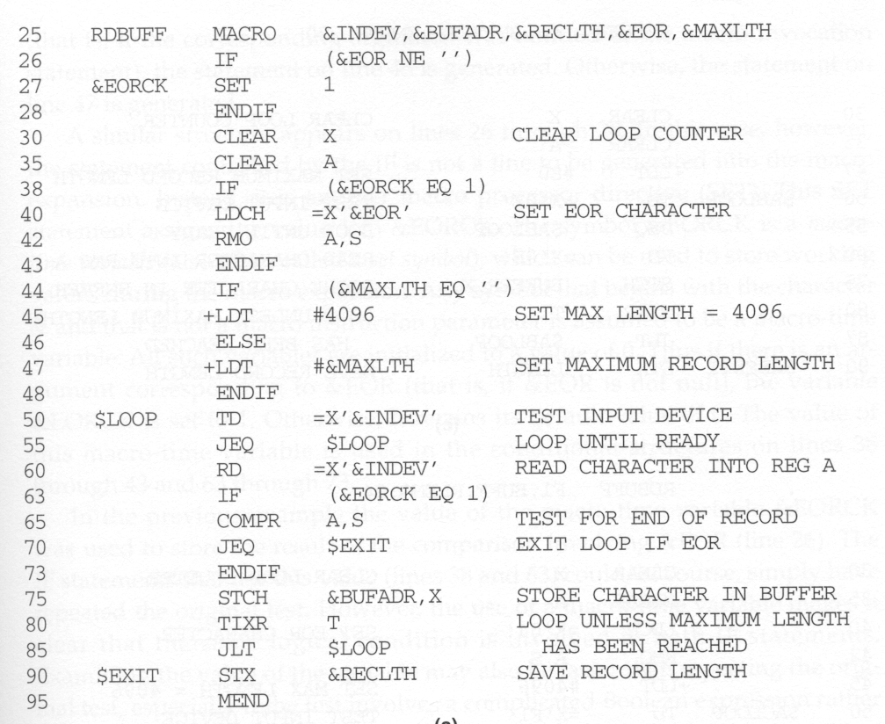
IF-ELSE-ENDIF Structure
Macro-time variable
Boolean expression

Slide 11
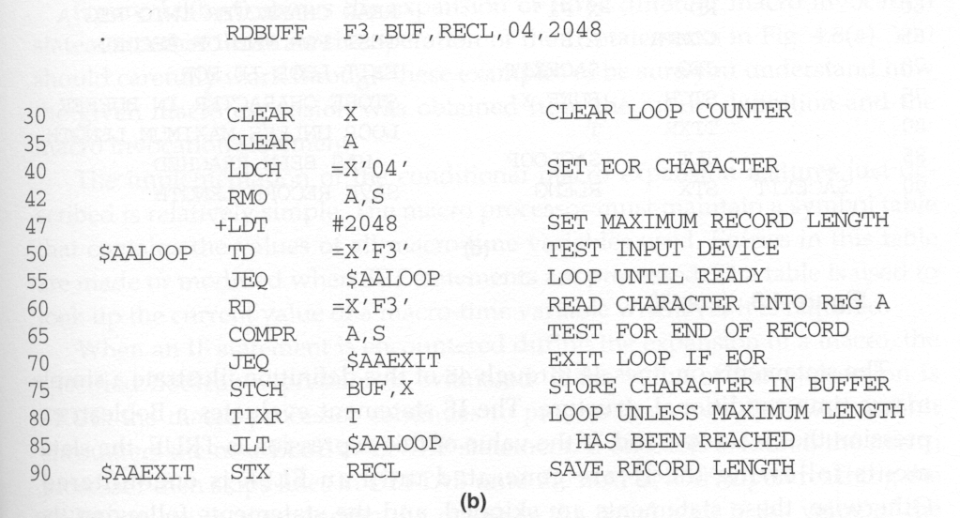
Example of Conditional Macro Expansion

Slide 12
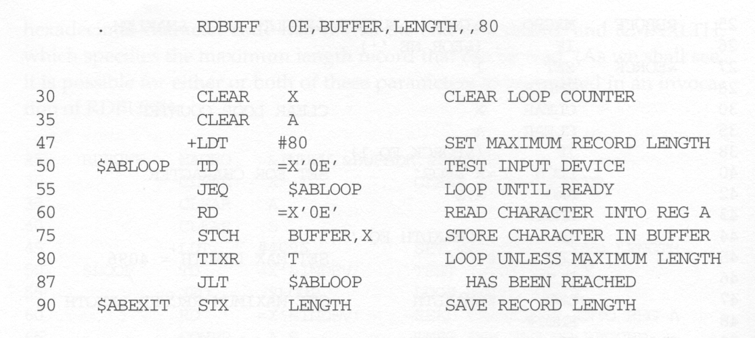
Example of Conditional Macro Expansion

Slide 13
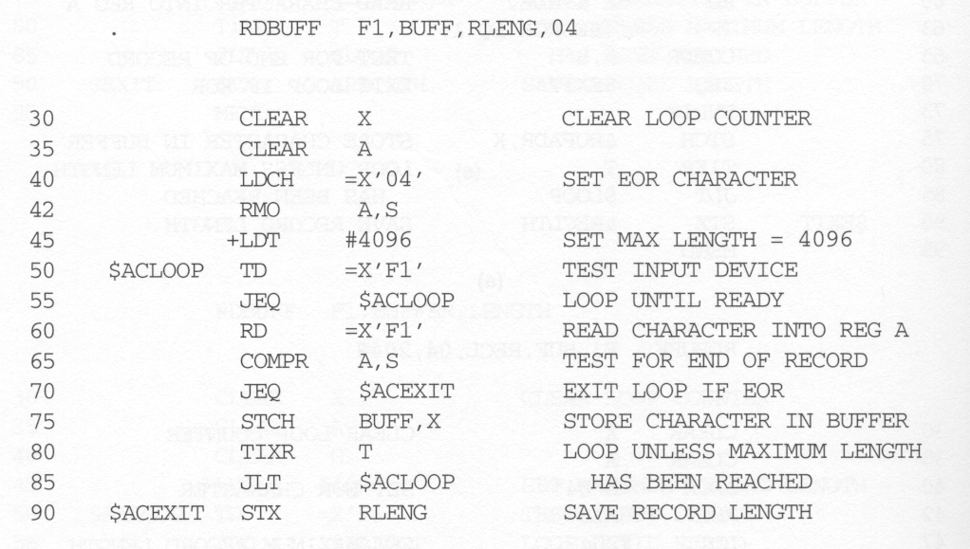
Example of Conditional Macro Expansion

Slide 14
Implementation of Conditional Macro Expansion
(IF-ELSE-ENDIF Structure)
A symbol table
  This table contains the values of all macro-time variables used.
  Entries in this table are made or modified when SET statements are processed.
  This table is used to look up the current value of a macro-time variable whenever it is required.
When an IF statement is encountered during the expansion of a macro, the specified Boolean expression is evaluated.
  TRUE
    the macro processor continues to process lines from DEFTAB until it encounters the next ELSE or ENDIF statement.
    If ELSE is encountered, then skips to ENDIF
  FALSE
    the macro processor skips ahead in DEFTAB until it finds the next ELSE or ENDLF statement.

Slide 15
Conditional Macro Expansion vs. Conditional Jump Instructions
The testing of Boolean expression in IF statements occurs at the time macros are expanded.
  By the time the program is assembled, all such decisions have been made.
  There is only one sequence of source statements during program execution.
In contrast, the COMPR instruction tests data values during program execution. The sequence of statements that are executed during program execution may be different.

Slide 16
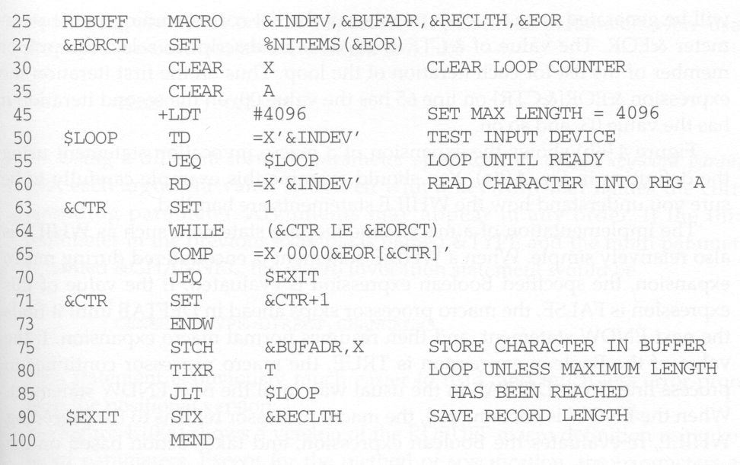
WHILE-ENDW Structure
Macro processor function
Macro-time looping statement

Slide 17
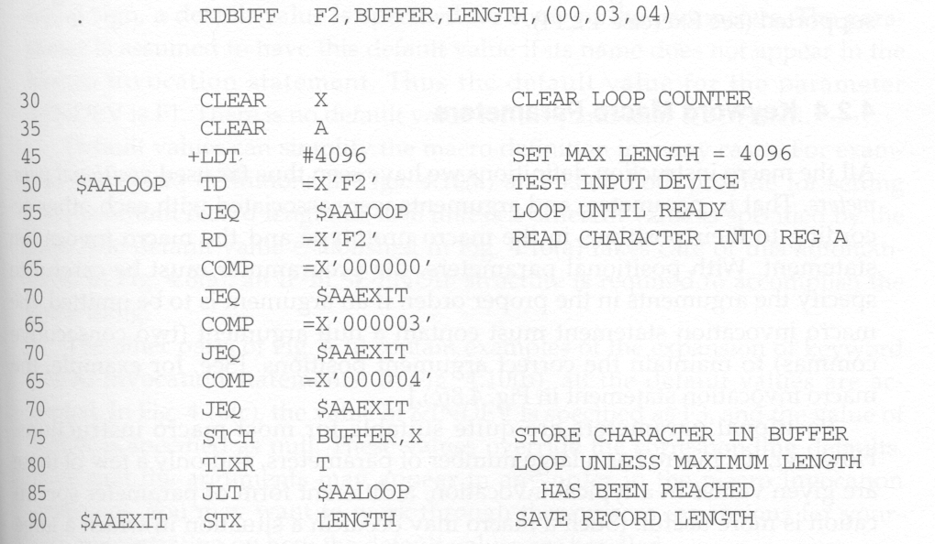
WHILE-ENDW Structure
A list of end-of-record characters

Slide 18
Implementation of Conditional Macro Expansion
(WHILE-ENDW Structure)
When an WHILE statement is encountered during the expansion of a macro, the specified Boolean expression is evaluated.
  TRUE
    the macro processor continues to process lines from DEFTAB until it encounters the next ENDW statement.
    when ENDW is encountered, the macro processor returns to the preceding WHILE, re-evaluates the Boolean expression, and takes action again.
  FALSE
    the macro processor skips ahead in DEFTAB until it finds the next ENDW statement and then resumes normal macro expansion.

Slide 19
Keyword Macro Parameters
Positional parameters
  Parameters and arguments are associated according to their positions in the macro prototype and invocation.
  If an argument is to be omitted, a null argument should be used to maintain the proper order in macro invocation:
  For example: GENER ,,DIRECT,,,,,,3.
  It is not suitable if a macro has a large number of parameters, and only a few of these are given values in a typical invocation.
Keyword parameters
  Each argument value is written with a keyword that names the corresponding parameter.
  Arguments may appear in any order.
  Null arguments no longer need to be used.
  For example: GENER TYPE=DIRECT,CHANNEL=3.
  It is easier to read and much less error-prone than the positional method.

Slide 20
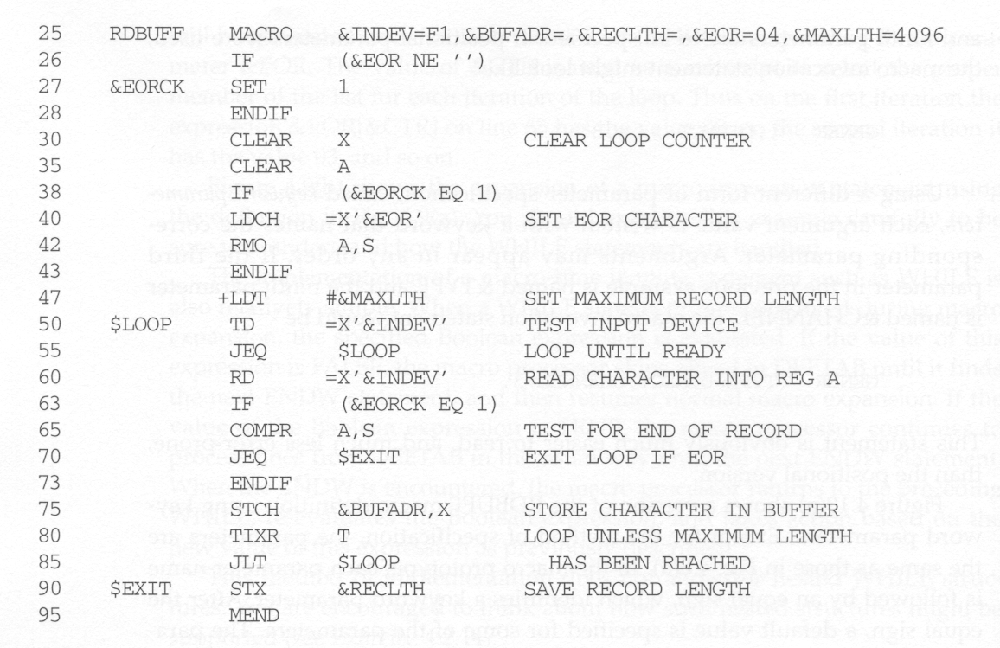
Example of Keyword Parameters
Default values of parameters

Slide 21
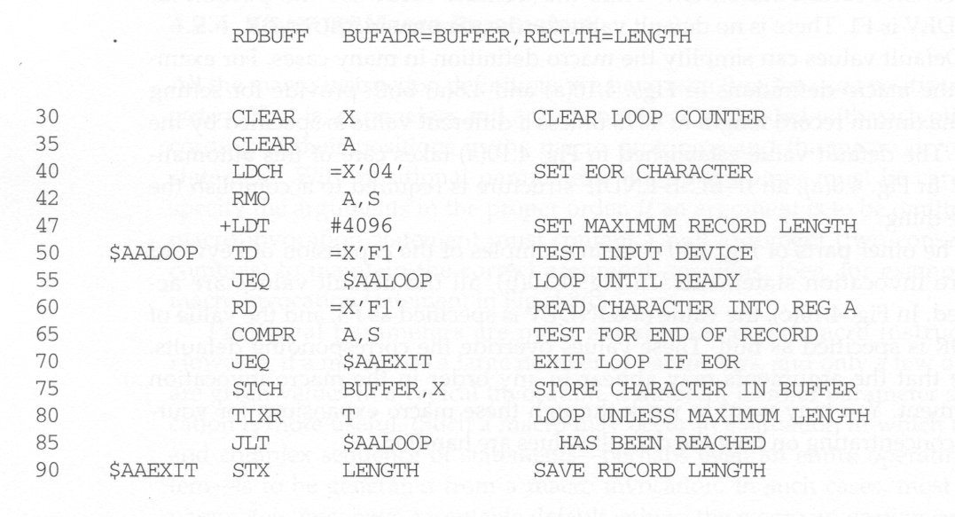
Example of Keyword Parameters

Slide 22
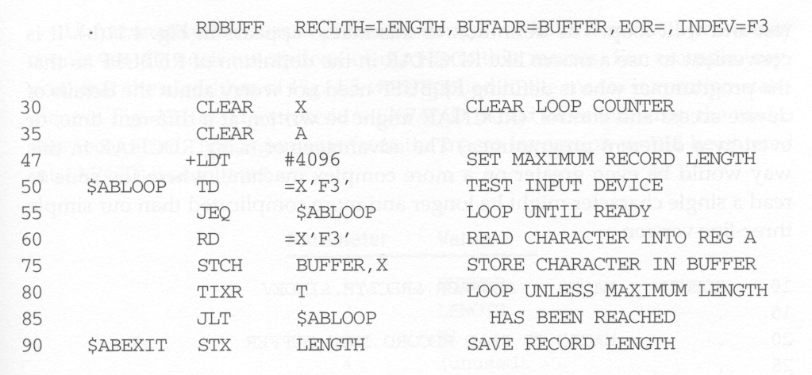
Example of Keyword Parameters

